Slide 1
University Data Model
Tushar Pagadala Ashok - 002130680
Pramod Chandraprakash Sony - 001563759
Uday Siddharth Kadiyala Sai - 002192624

Slide 2
Agenda
Problem Statement
Proposed Solution and User Interface
Implementing new capabilities in Diagrams
Highlights

Slide 3
Problem Statement
Study ways to create a performance measurement solution to enable universities to measure the quality of the education they deliver to their students.
The approach will be to look into how an educational system in terms of faculty and courses contribute to the growth of their graduates over a 5-year period.
You must figure out ways to track the jobs and promotions graduates get over time and assign rankings accordingly. In addition, track the connection of courses and their relevance to graduates' growth.
One additional question is to consider ways to define your own ranking system for students to decide where they want to go for their studies.

Slide 4
Proposed Solution

Slide 5
Performance and Feedback
Current Student
Alumni
Its crucial that we have a survey system designed for current students to give feedback
Another performance factor, is the average grade scored and ranking of students in that course.
Having these parameters will act as a driving factor for any revisions in the curriculum and also influence a prospective student in applying to this course.
Provides an overall survey on the all the courses
Another performance factor, is the average grade scored and ranking of Alumni in that course.
Employment History and Certifications –
How related are the courses to the jobs of an Alumni? And is it biased towards research?
Did he need any additional Certifications?
Having these parameters will act as a driving factor for any revisions in the curriculum and influence a prospective student in applying for this course or encourage a potential employer to hire Students from this Course.
Prospective Student
Additional factor to consider is how these ratings would influence new applicants in applying to courses at the University or on how the Alumni flared well in their career.
The Course ratings and survey given by both the current students and Alumni will help them choose an appropriate course.

Slide 6
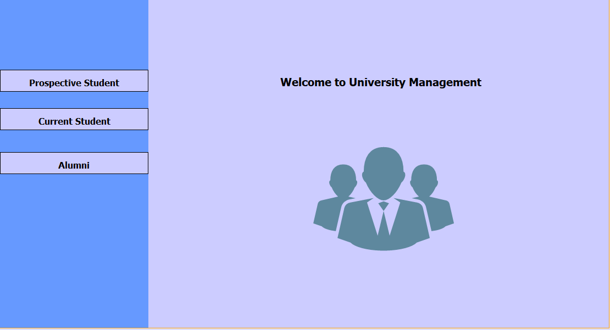
User Interface based on Roles
This Panel serves as a login page for three roles – Prospective Students, Current Student and Alumni

Slide 7
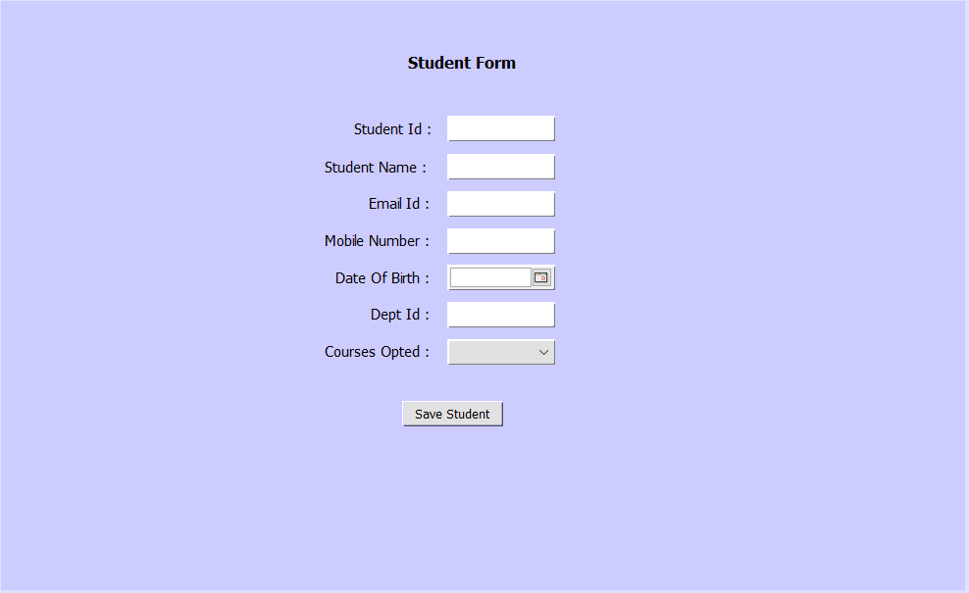
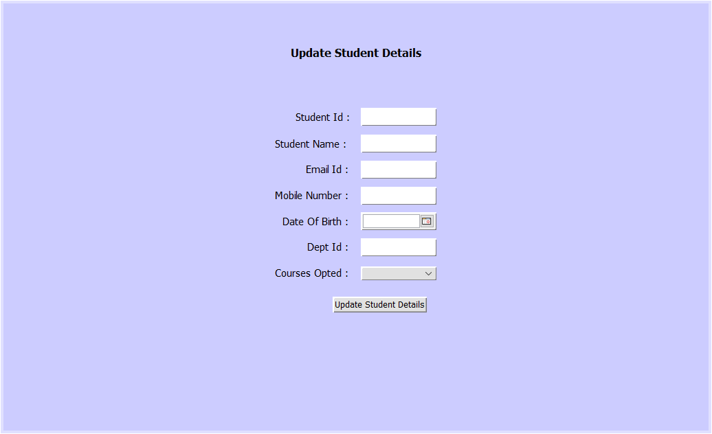
Role of Current Student
Register the Name, Department and other information

Slide 8
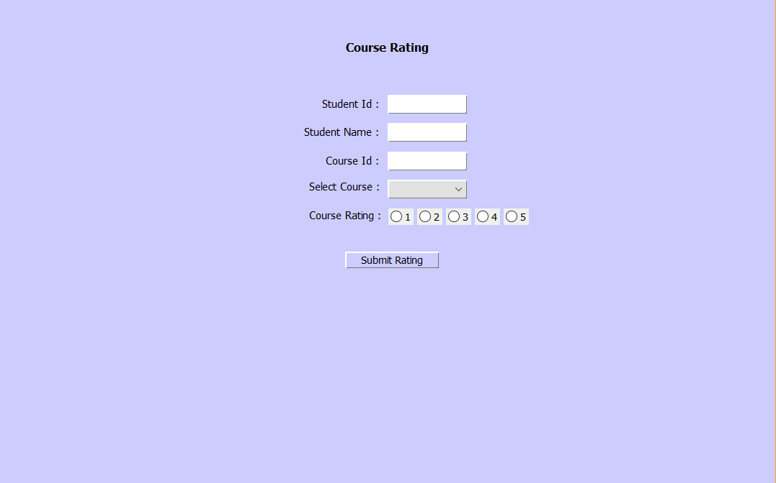
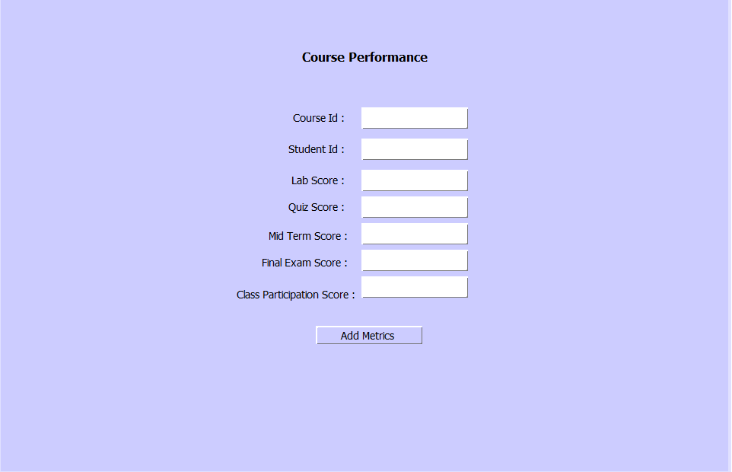
Role of Current Student
Provide rating for each course. The rating metrics range from 1(Very Bad) to 5(Very Good)
Register their grades on the system.

Slide 9
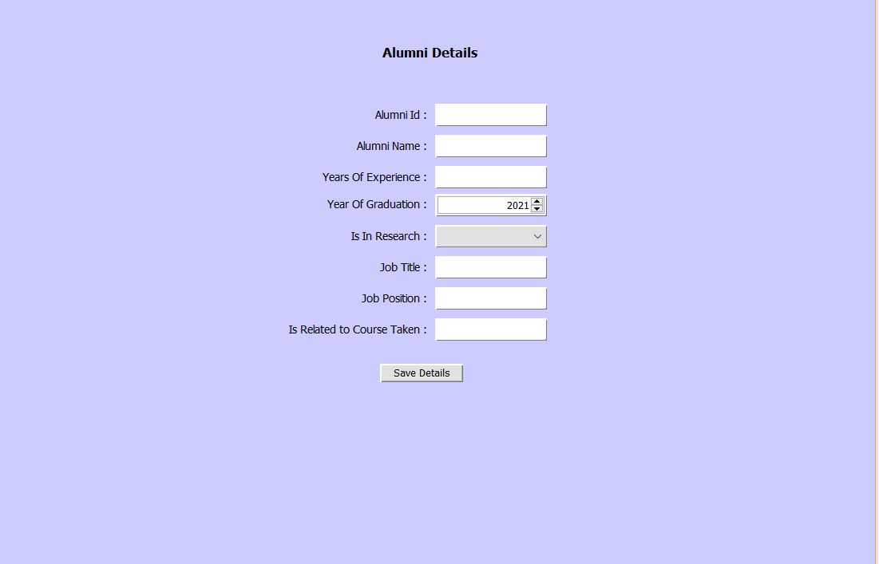
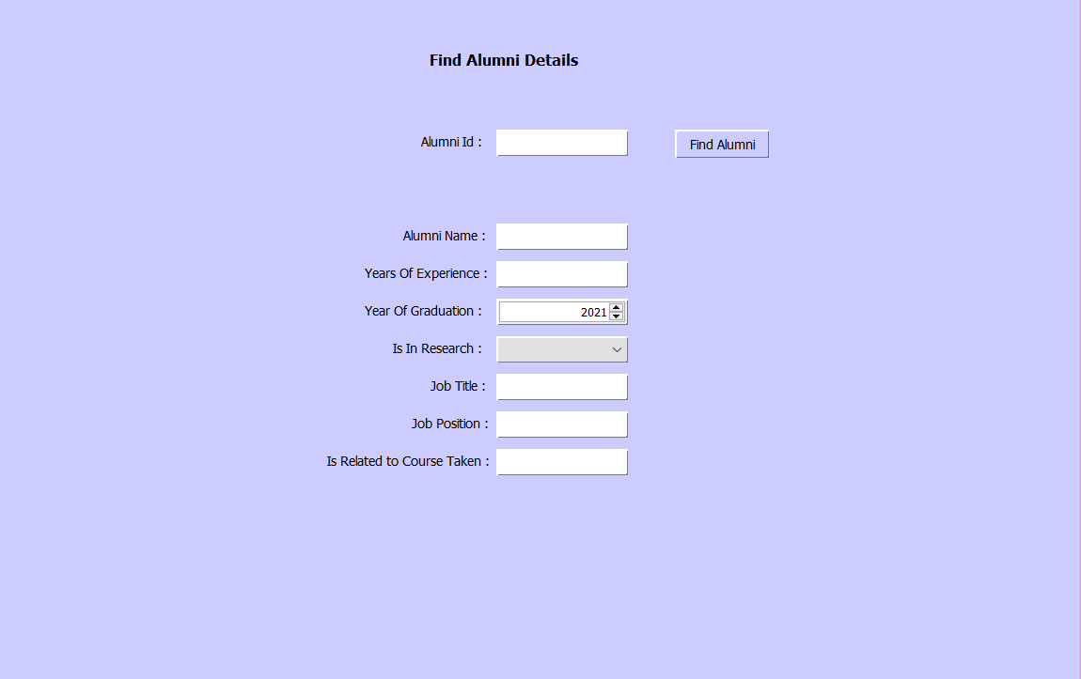
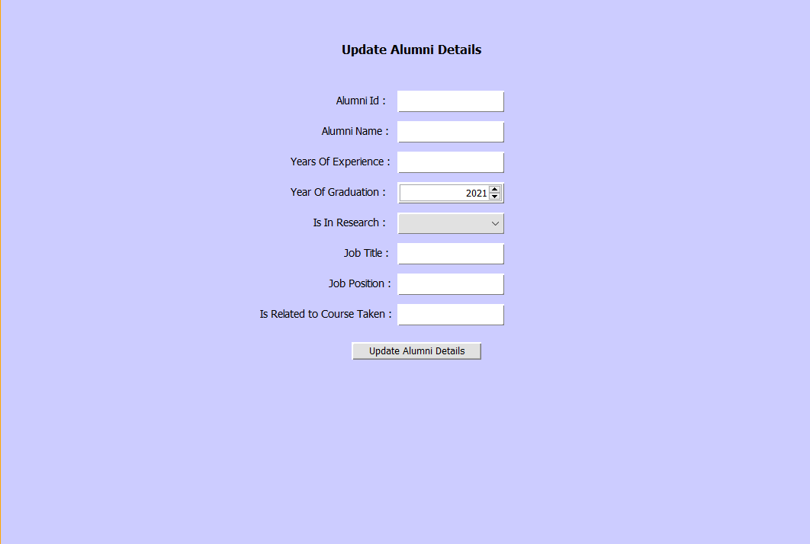
Role of Alumni
registers their overall GPA, their research background, Years of experience and Job Profile.

Slide 10
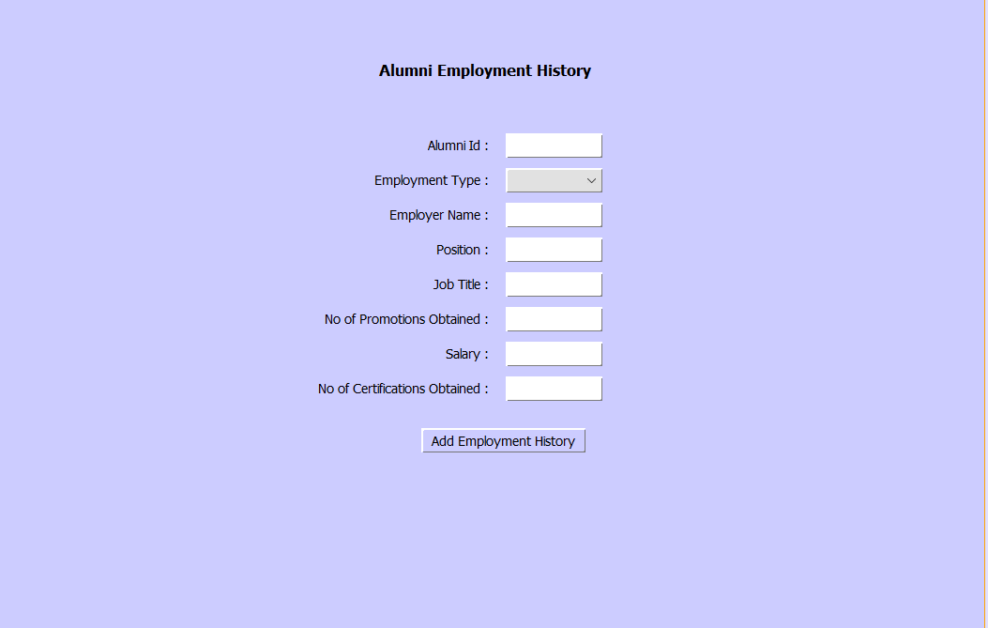
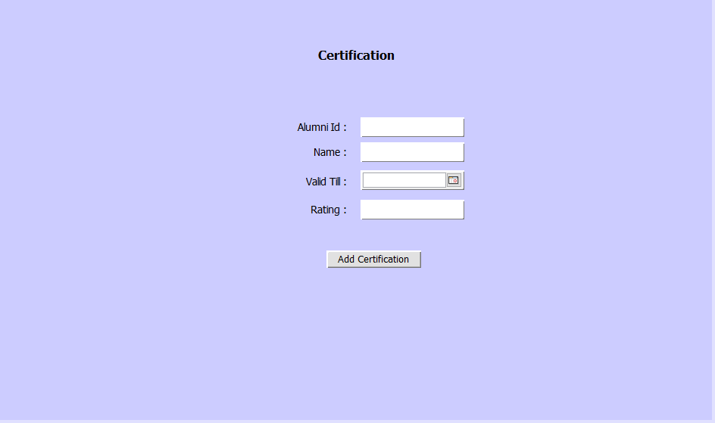
Role of Alumni
Provide rating for each course. The rating metrics range from 1(Very Bad) to 5(Very Good)
Registers the Employment History and provides the list of Certifications.

Slide 11
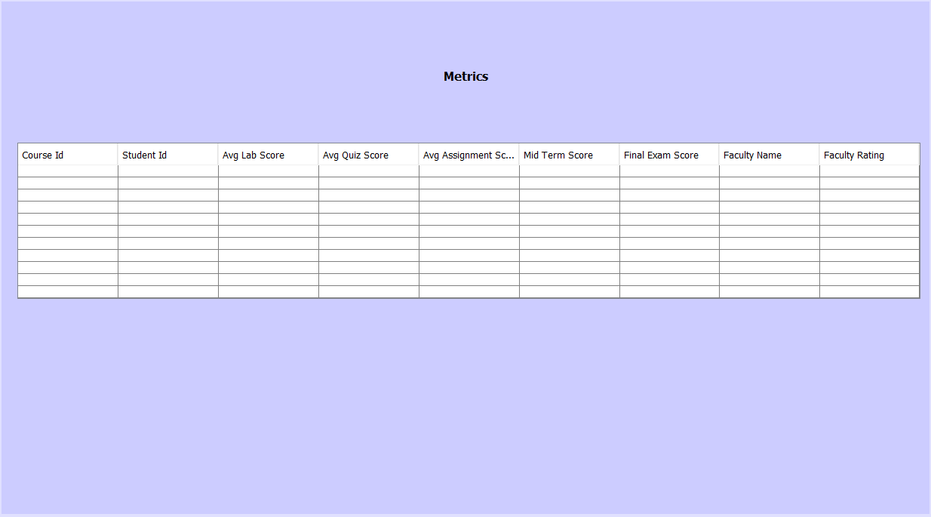
Role of Prospective Student
Can login using an applicant ID and access the metrics of the course, Student or Alumni rating.
Theses metrics will serve as ranking system which will enable the applicants to choose their courses.
Can procure Top Ranked Alumni and Current Students based on Courses

Slide 12
Class and Sequence Diagrams

Slide 13
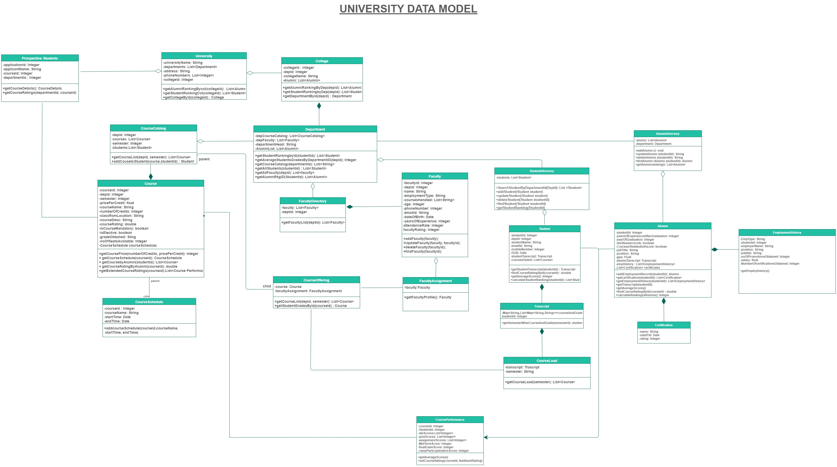

Slide 14
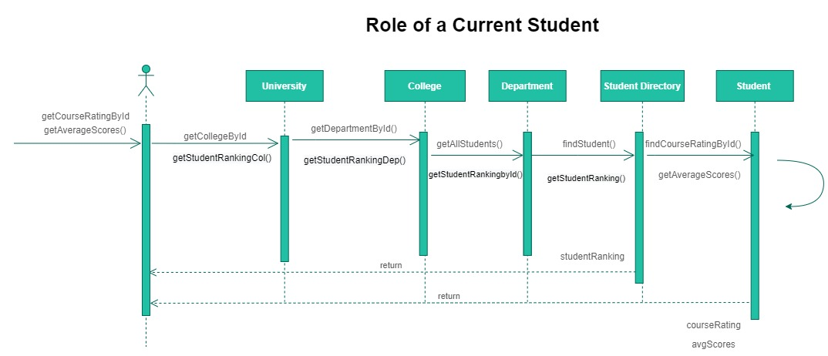

Slide 15
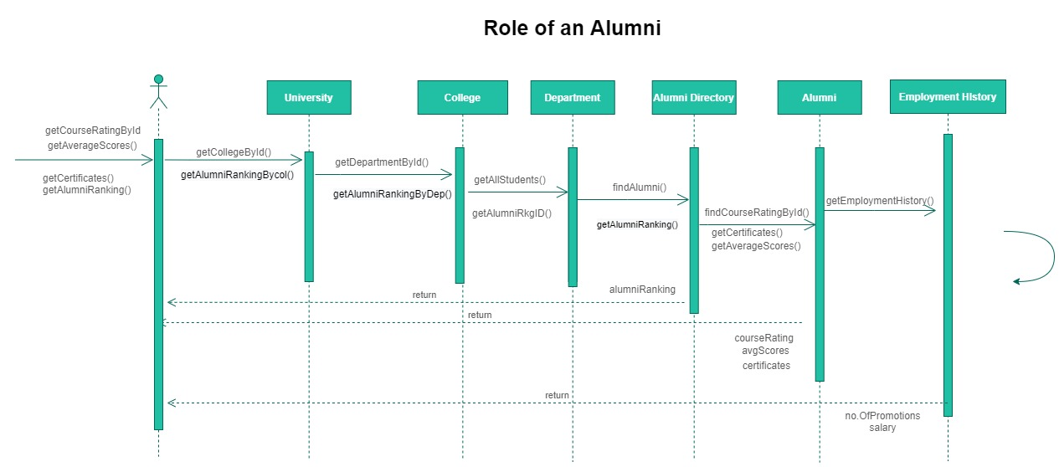

Slide 16
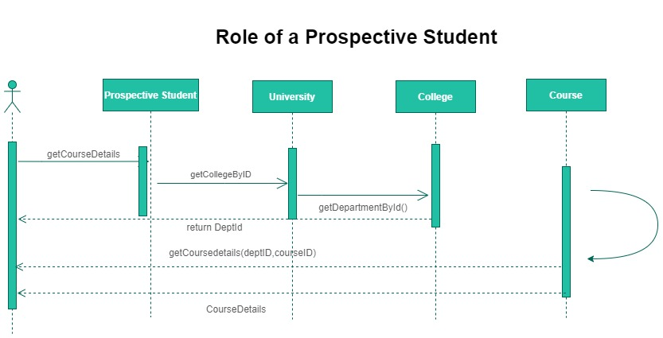

Slide 17
Highlights
Improve Course Curriculum and add additional certifications
Match the courses to current technologies
Determine the demerits by looking into lower ranked Students
Improve the course paedology based on Alumni Employment History and their research experience.
Course Rating
Current Student
Standing in Course
Alumni
Feedback
Prospective Student
Course Rating
Course Rating
Alumni Ranking
Alumni Success Rate
1
2
3

Slide 18
Thank you

